Slide 1
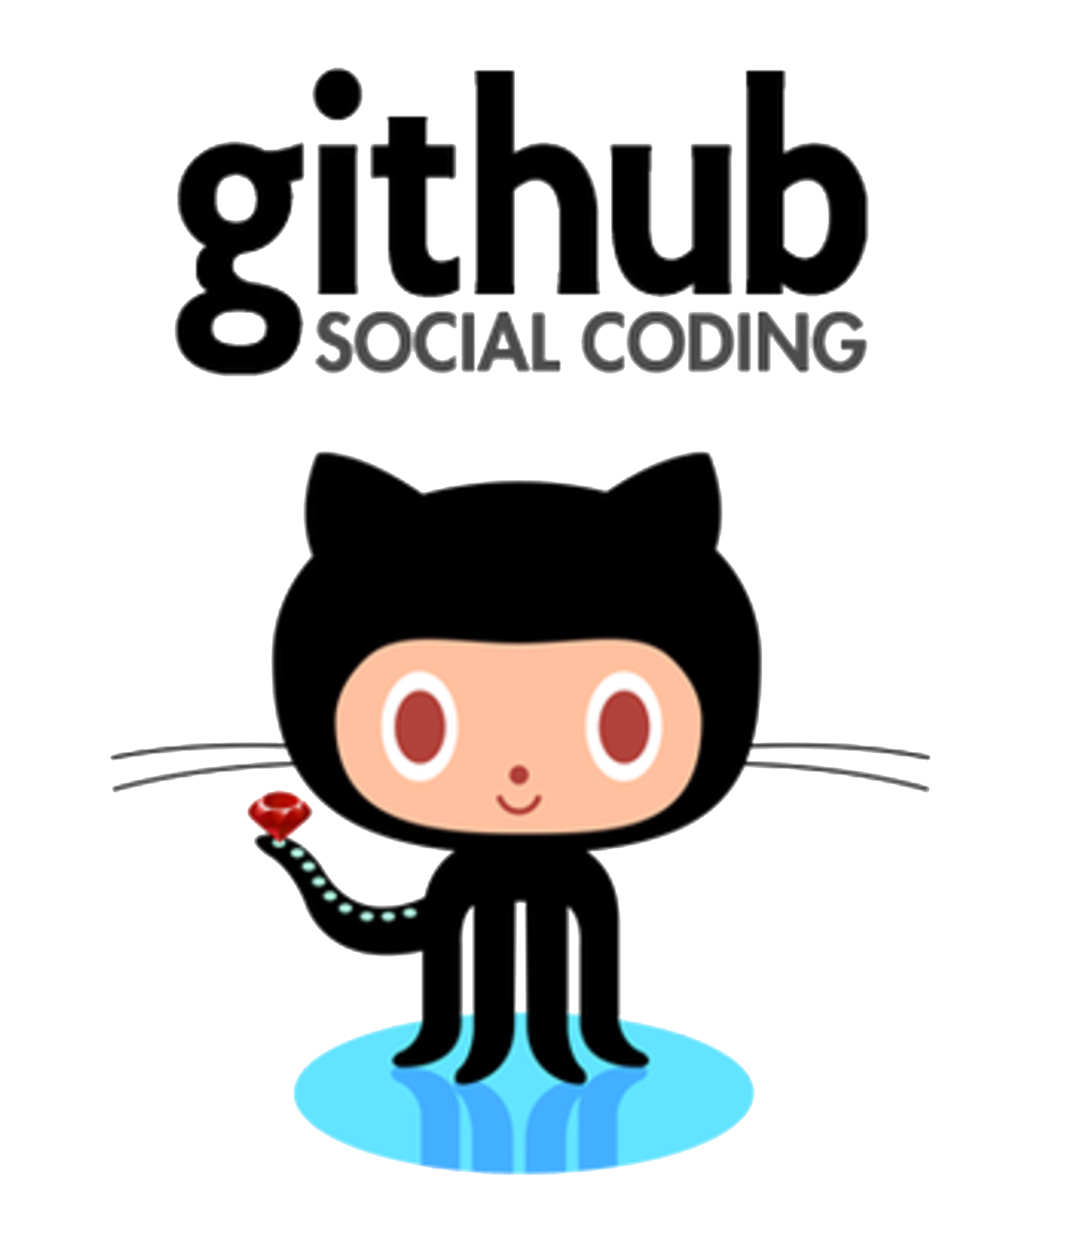

Slide 2
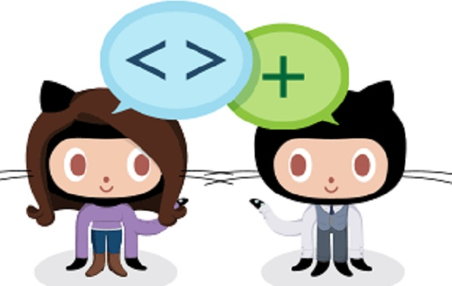
ROADMAP Introduction!
What is GitHub ?
Configuring Git
Command line interface
Basic Git Commands line
Terminology

Slide 3
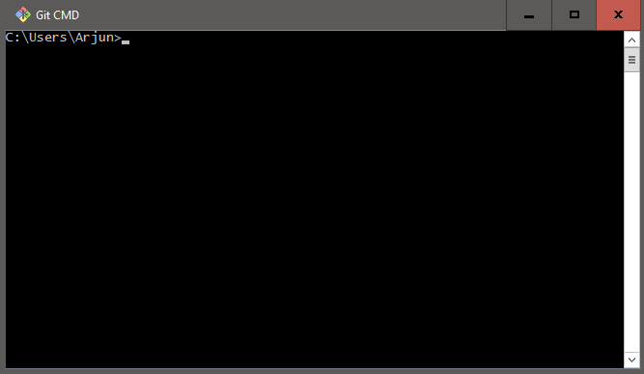
Command line Interface (CLI)
Windows ( Git Bash)
Mac/Linux ( Terminal)
The CLI can help you:
Navigate folders
Create files, folders, programs
Edit Files, Folders and programs
Run computer programs

Slide 4
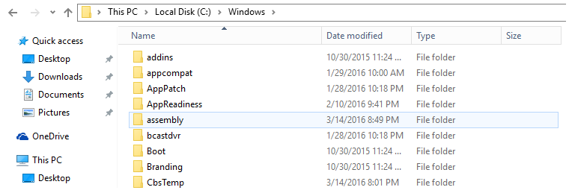
Directories
Is another name for Folder
Has a tree structure.
Directories can be inside another directories
Directories can be navigated through CLI
This pc/Local disk/ windows

Slide 5
Version Control
Version Control is a function that records files over time so that you can recall for a specific version later on.
Server computer
- Version 1
-Version 2
-Version 3
Computer A
-Version 1
-Version 2
-Version 3
Computer B
-Version 1
-Version 2
-Version 3

Slide 6
Git
Git is a version control system
Created by by Linus Torvalds
Operated from command line
Everything is stored in Repository

Slide 7
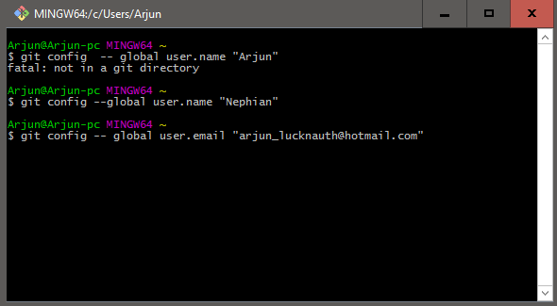
Configuring Git
git config --global user.name "Your Name Here"
git config --global user.email "your_email@youremail.com"

Slide 8
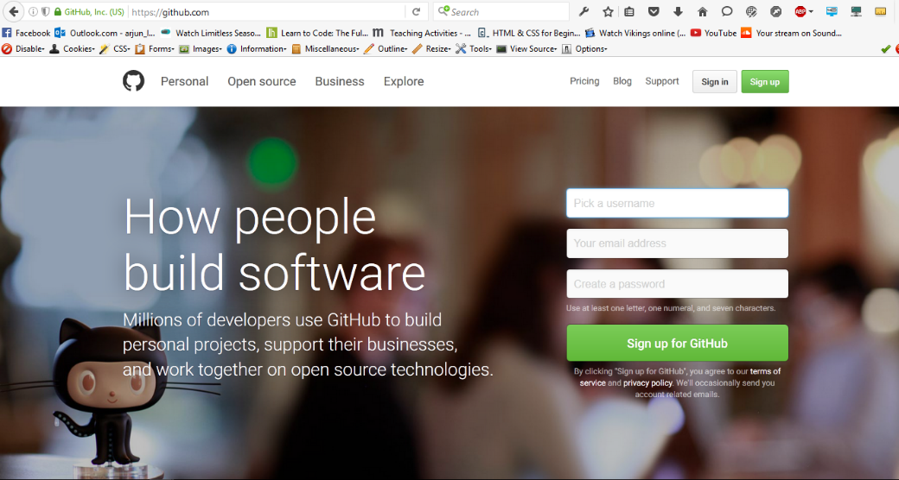
GitHub
GitHub is a web-based hosting service for Git
Allows users to “Push” and “Pull” their local repositories to and from remote repositories on the web
Provides users with a homepage that displays public repos
Allows users to create account, follow each other and share projects.
Download: http//github.com/

Slide 9
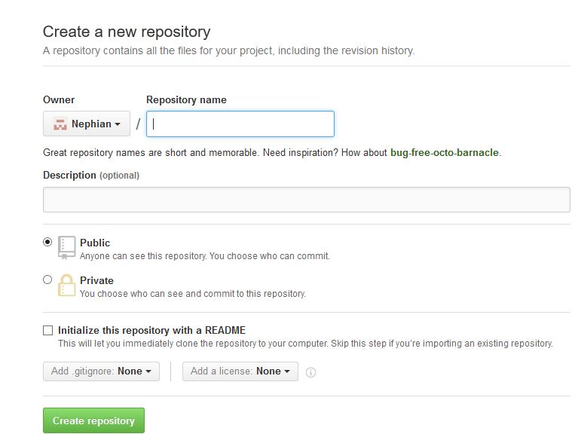
Creating a GitHub Repository
Two methods of creating a GitHub repository :
Start a repository from scratch
“Fork” another user’s repository
https://github.com/”YourUserName”
Create a name for a repo, select “public”, make a brief description and click on “create repository”.

Slide 10
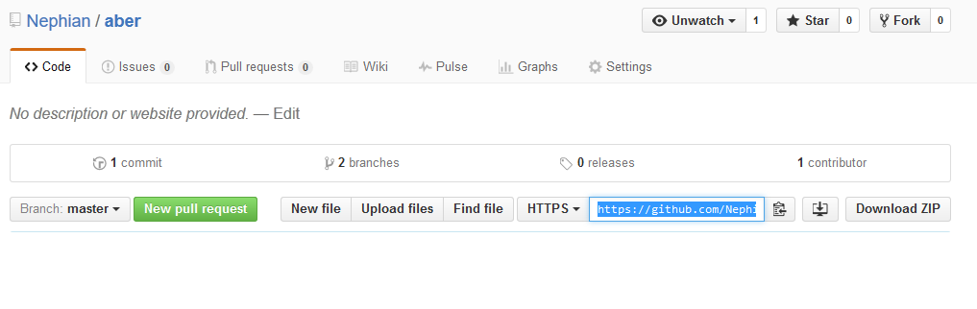
Creating a local copy
Now you need to create a copy of this repo on your computer so that you can make changes to it !
Open Git Bash
Create a directory on your computer to store your copy of the repo
Navigate to this new directory using “cd”
Initialize a local Git repo in this directory with “ git init”
Point your local repository at the remote repository you just created on the GitHub server.
E.g

Slide 11
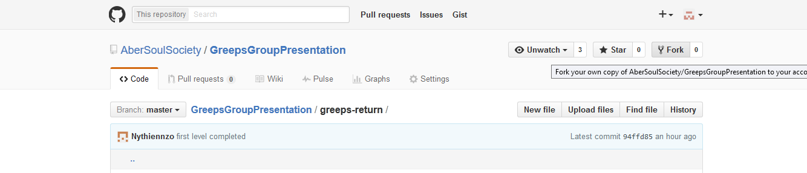
“Forking”
The second method of creating a repo is by making a copy of someone else’s.
This process is called “forking”
Go on Github > Explore>click on a project you are interested.
Click on Fork

Slide 12
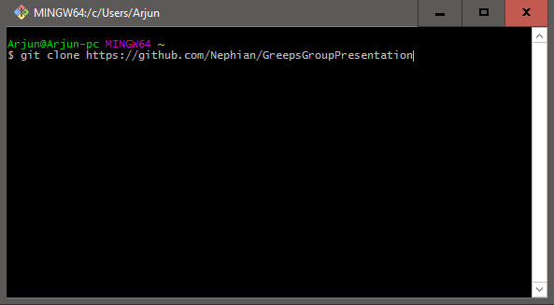
Clone the repo
So there’s a copy of the repo in your Github account.
You need to make a copy on your local computer.
This process is called “cloning”. You can do it with the following command:
Git clone https//github.com/YourUserName/Name of forked file.

Slide 13
Branches
Create branch of Master project so that other people can work at the same time as you are.
To branch a repo you can use this command
$ git checkout –b branch”name”
To see what branch you are on:
$ git branch
To switch back to the master branch type:
$ git checkout master

Slide 14
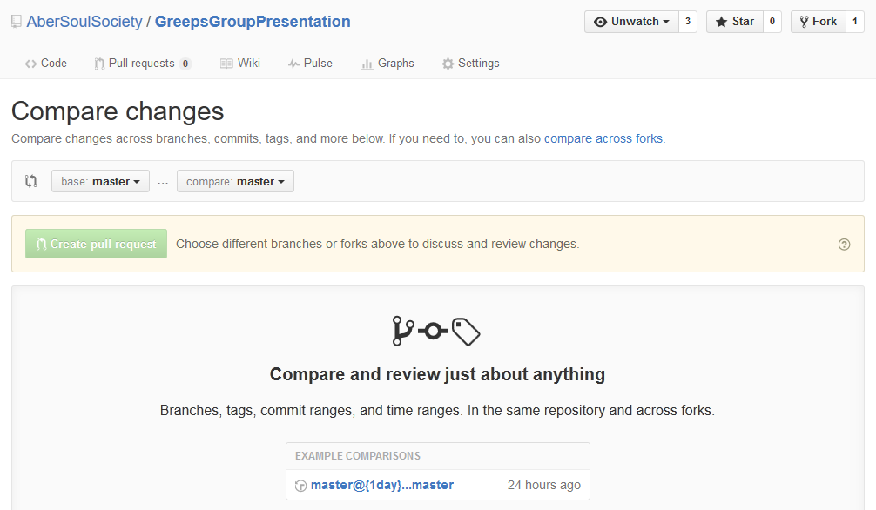
Pull request
Allows other people to see changes you made.
People interested can review changes, discuss modifications and even push follow up.
You can pull request from Github’s website. This will enable you to compare work.

Slide 15
Adding
If you add new files to a local repo, you need to let Git know so that it is tracked.
Note : This should always be done before committing.
You can use the following commands.
git add –u (updates tracking for files that changed names or were deleted
git add-A Does both of the previous steps.

Slide 16
Terminology used on GitHub
Repository
Version control
Commit
Branch
“Forking”
Master
Users
Users
Users
Users

Slide 17
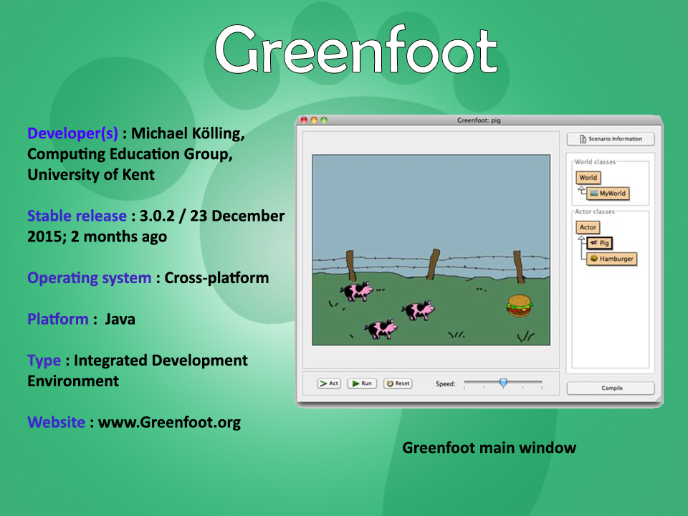
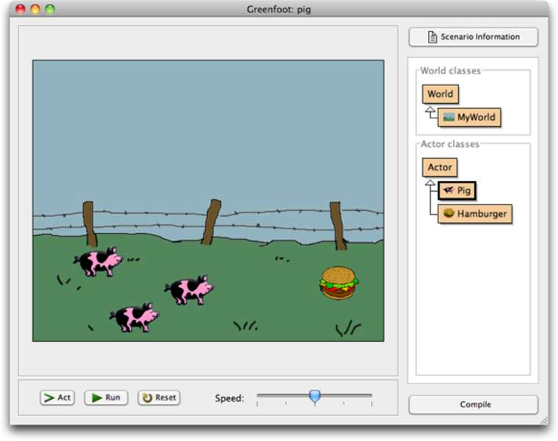
Greenfoot
Developer(s) : Michael Kölling, Computing Education Group, University of Kent
Stable release : 3.0.2 / 23 December 2015; 2 months ago
Operating system : Cross-platform
Platform : Java
Type : Integrated Development Environment
Website : www.Greenfoot.org

Slide 18
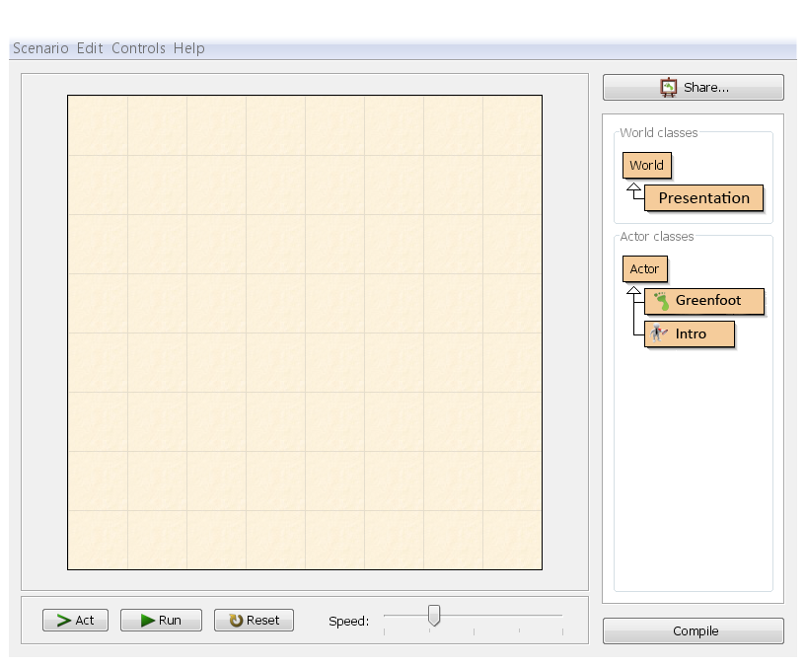

Greenfoot
Greenfoot is an interactive Java development environment designed primarily for educational purposes at the high school and undergraduate level, to help beginners gain experience with object-oriented programming.
Nutshell: Greenfoot is a tool for teaching programming with java language
It a combination between a framework for two-dimensional graphical applications in Java and an IDE, that allows development such as simulations and interactive games.

Slide 19
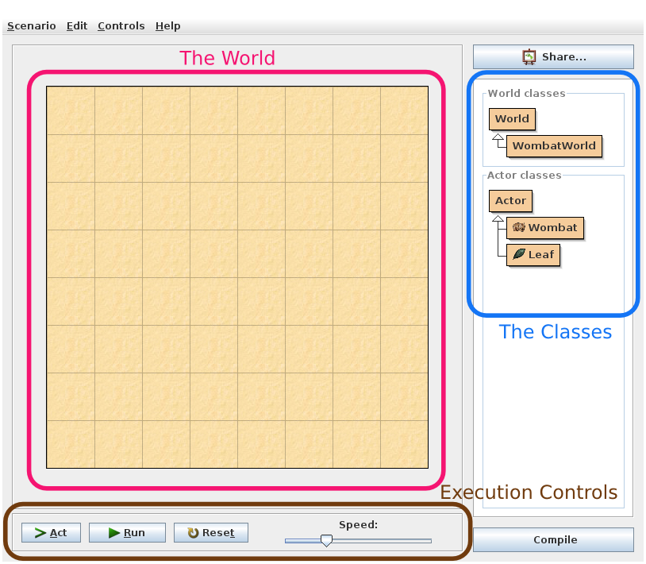
Visual Interface

Slide 20
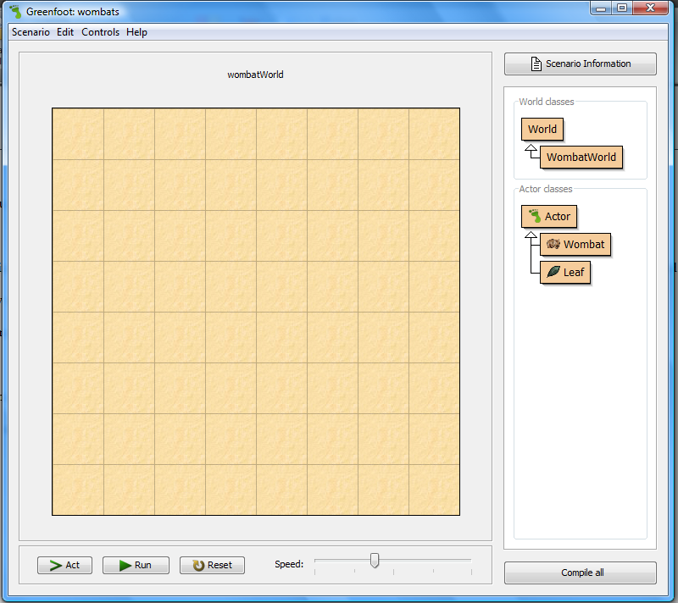
The World: where programs will run, where we will see things happen.
World

Slide 21
Class Diagram: This is the little beige boxes and arrows on the right.
It shows us the classes involved in this scenario. Here, we have 5 classes: World, Wombat World, Actor, Wombat, and Leaf.
The classes World and Actor will always be there – they come with the Greenfoot system.
The classes are specific to the wombat scenario. They may be different or not exist at all in other scenarios.
Class
Diagram

Slide 22
Class Diagram: This is the little beige boxes and arrows on the right.
Let’s start by looking at the Wombat class. It stands for the general concept of a wombat. So this class describes all wombats.
Once we have a class in Greenfoot (or Java), we can create objects from it.
Class
Diagram

Slide 23
Execution Controls: includes the Act, Run, and Reset buttons, and the speed slider.
The Act button is equivalent to invoking the act() method of every object exactly once.
The Run button is equivalent to continuously clicking the Act button. When clicked, the Run button becomes a Pause button, which pause the whole show.
The slider to the right of the buttons sets the speed.
Execution
Controls

Slide 24
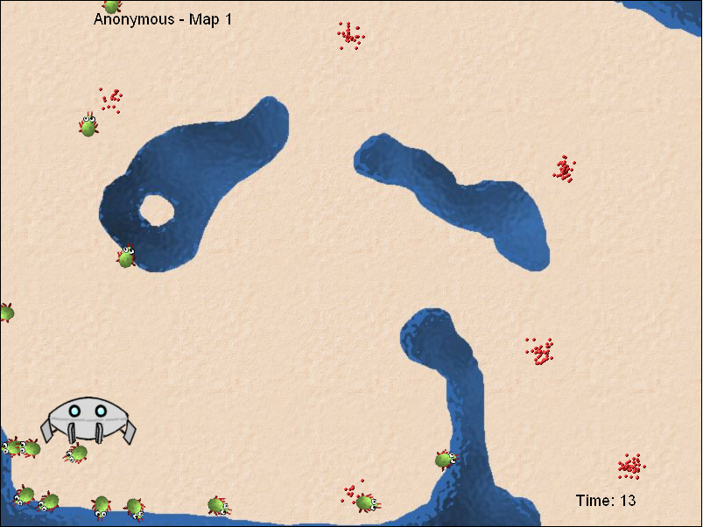
Greeps

Slide 25
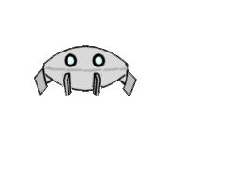

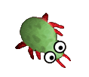
Greeps
A fun competition that teaches Java programming and computational problem-solving.
The programming experience needed to tackle this the greeps is quite modest: you need an understanding of variables, method calls with parameters, and if statements.
This exercise not only teaches Java—it gives people practice in computational problem-solving

Slide 26
Rule 1
Only change the class 'MyGreep'. No other classes may be modified or created.
Rule 2
You cannot extend the Greeps' memory. That is: you are not allowed to add
fields (other than final fields) to the class. Some general purpose memory
is provided. (The ship can also store data.)
Rule 3
You can call any method defined in the "Greep" superclass, except act().
Rule 4
Greeps have natural GPS sensitivity. You can call getX()/getY() on any object
and get/setRotation() on yourself any time. Friendly greeps can communicate.
You can call getMemory() and getFlag() on another greep to ask what they know.
Rule 5
No creation of objects. You are not allowed to create any scenario objects
(instances of user-defined classes, such as MyGreep). Greeps have no magic
powers - they cannot create things out of nothing.
Rule 6
You are not allowed to call any methods (other than those listed in Rule 4)
of any other class in this scenario (including Actor and World).

Slide 27
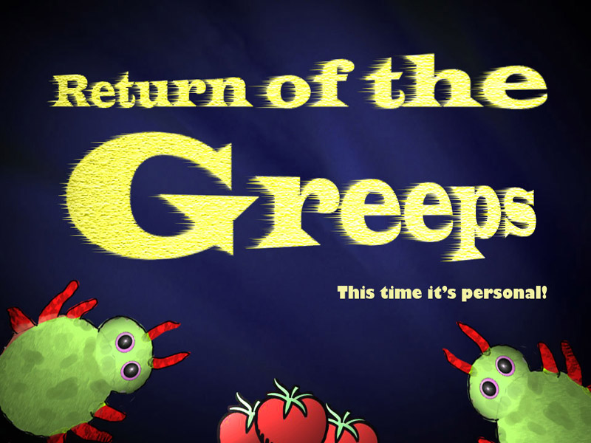

Slide 28
New updates
New features:
4 new maps
2 packs of greeps instead of 1
New powers:
kablam();
block();
getFriend();
turnTowards();

Slide 29
Questions?

